Slide 1
Unit-1
Introduction to HTML

Slide 2
Intranet
An intranet is a private network within an organization. It’s the most restrictive of the three networks.
It is designed to facilitate communication, collaboration, and information sharing among the members of the organization or the authorized users within the organization.
It is commonly used for sharing internal documents, announcements, resources and to manage internal operations. They can also be used to facilitate team collaboration and project management.
Intranets offer several benefits over traditional methods of communication and collaboration, such as email or phone calls. They provide a centralized location for storing and accessing information, which makes it easier for employees to find what they need quickly.

Slide 3
Extranet
An extranet is a controlled extension of an organization's intranet (private Network) that allows external users, such as customers, suppliers, and partners, to access certain parts of an organization's intranet.
It provides a secure and controlled environment for external entities to access specific resources or collaborate with the organization.
Extranets can be used to share product information, order status, or other relevant data with customers. They can also be used to collaborate with suppliers on product development or logistics.

Slide 4
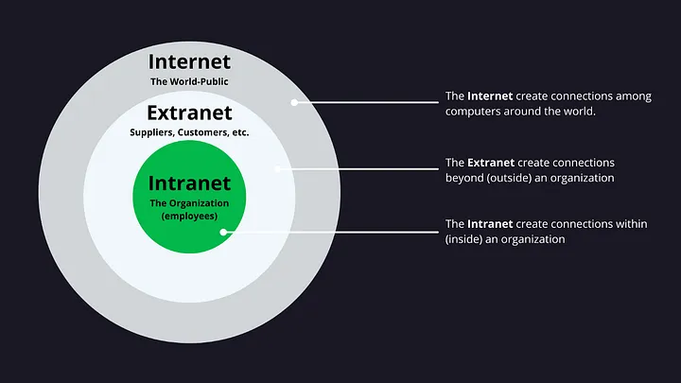

Slide 5
World wide web (www)
WWW stands for the World Wide Web, and it is a system of interlinked hypertext documents accessed via the internet. The WWW was initiated by CERN (European library for Nuclear Research) in 1989.
The term "www" (World Wide Web) is closely associated with Sir Tim Berners-Lee, who is credited with inventing the World Wide Web.
Tim Berners-Lee, a British computer scientist, proposed the concept of the World Wide Web in 1989 while working at CERN (European Organization for Nuclear Research) for researchers to work together effectively.
Tim Berners-Lee founded the World Wide Web Consortium (W3C) in 1994 to oversee the development of web standards and ensure the continued evolution and interoperability of the World Wide Web.

Slide 6
Components of the Web
There are 3 components of the web:
Uniform Resource Locator (URL): serves as a system for resources on the web.
HyperText Transfer Protocol (HTTP): specifies communication of browser and server.
Hyper Text Markup Language (HTML): defines the structure, organisation and content of a webpage.

Slide 7
URL – Uniform Resource Locator
A URL, or Uniform Resource Locator, is a reference or address used to access resources on the internet.
Protocol: This indicates the communication protocol used, such as HTTP (Hypertext Transfer Protocol) or HTTPS (Hypertext Transfer Protocol Secure).
Domain or IP Address: This part specifies the location of the server hosting the resource. It could be a domain name (e.g., www.example.com) or an IP address (e.g., 192.168.0.1).
Path to Resource: This is the specific location or file on the server that you want to access.

Slide 8
HTTP
Stands for HyperText Transfer Protocol
Allows computers on the WWW to communicate with one another.
Handles the “request” sent to the Web server and the “response” received from the Web server.

Slide 9
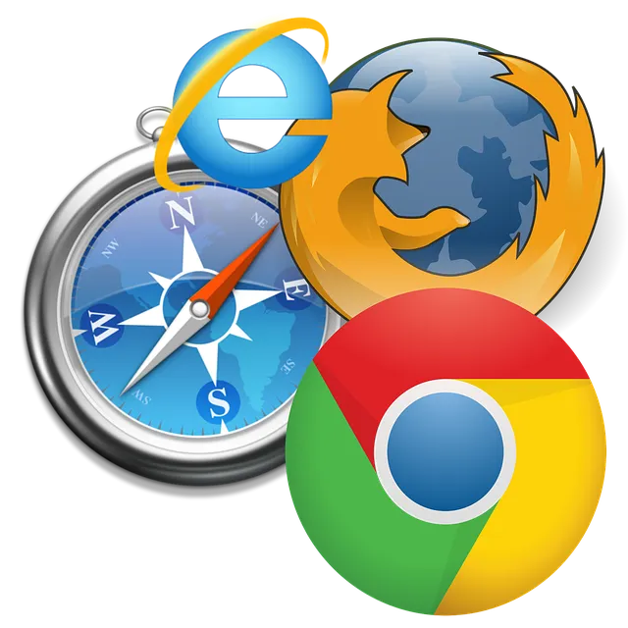
Web Browsers
A software application used to access information on the World Wide Web is called a Web Browser. It is an interface between us and the information available on the web and helps in interpreting and displaying content from websites.
1990 – The WorldWideWeb (not to be confused with the World Wide Web) was the first browser ever created by W3C Director Tim Berners-Lee, then renamed Nexus to differentiate from the actual World Wide Web. Unlike today, this was the only browser and the only way to access the web.
1992 – Lynx was a texted-based browser that couldn’t display any graphic content.
1993 – Mosaic was the first browser to allow images embedded in text making it “the world’s first most popular browser”.

Slide 10
1994 – A noticeable improvement to Mosaic came Netscape Navigator.
1995 – Internet Explorer made its debut as Microsoft’s first web browser.
1996 – Opera started as a research project in 1994 that finally went public two years later.
2003 – Apple’s Safari browser was released for Macintosh computers instead of Navigator.
2004 – Mozilla launched Firefox as Netscape Navigator faded out.
2007 – Mobile Safari was introduced as Apple’s mobile web browser.
2008 – Google Chrome appeared to soon take over the browser market.
2011 – Opera Mini was released to focus on the fast-growing mobile browser market.
2015 – Microsoft Edge was born to combat Google.

Slide 11
Functions of Web Browser
Web browsers provide a graphical user interface (GUI) that allows users to interact with the internet easily and to retrieve information from the World Wide Web.
Rendering Engine: Browsers use a rendering engine to interpret and display web content.
Provide navigation facilities for users: Navigation control is another function of the internet browser. All browsers have menus, tabs, and many other features that are used to navigate around the website and the internet generally.
Caching of most frequently accessed data to increase browsing speed: The web browser saves the content that users retrieve frequently to save time when retrieving data from the server. Instead of getting the page from the server, it retrieves some components that were saved in the client computer for fast operation.

Slide 12
Plugins and Extensions: Browsers often support plugins or extensions that enhance functionality. These add-ons can include ad blockers, password managers, and other tools that customize the browsing experience.
Security Features: Web browsers incorporate various security measures to protect users from malicious content and activities. This may include features like pop-up blockers, secure connections (HTTPS), and warnings about potentially unsafe websites.

Slide 13
Web Server
A web server is software and hardware that uses HTTP (Hypertext Transfer Protocol) and other protocols to respond to client requests made over the World Wide Web.
The main job of a web server is to display website content through storing, processing and delivering webpages to users.

Slide 14
Local Web Servers
As the name suggests a local server is a privately owned machine most commonly used by developers to store and test the web pages that have server-side scripting codes.
In other words, a local web server is typically installed and run on the user's own computer.
A local server can be your laptop or Personal Computer giving you the complete environment (software & hardware) for developing a web application.
Popular local web server software includes Apache, Nginx, Microsoft Internet Information Services (IIS), and others.
Developers can install a local server environment such as XAMPP, WampServer, or MAMP, which include a web server, database server, and other components needed for web development.

Slide 15
Remote Web Servers
Remote server refers to a computer that is remotely located having a web server software, database and other resources to handle remote requests sent by the users of a website.
Remote servers are used for hosting websites and applications that are accessible over the internet.
It has to be powered to process the scripting language codes in the web pages.

Slide 16
Search Engine and its Working
Search engines are searchable databases of web content. They’re made up of two main parts:
Search index. A digital library of information about webpages.
Search algorithm(s). Computer program(s) tasked with matching results from the search index.
Search engines have two types of search results:
Organic results from the search index. You can’t pay to be here.
Paid results from advertisers. You can pay to be here.

Slide 17
The process of how a search engine works can be broken down into several key stages:
Crawling:
Search engines use automated programs called web crawlers or spiders to systematically browse the web. These crawlers start by visiting a set of known web pages, extracting links from those pages, and then visiting the linked pages.
Everything begins with a known list of URLs. The three most common ways of accessing url are:
From backlinks. Google has an index of hundreds of billions of webpages. If someone links to a new page from a known page, Google can find it from there.
From sitemaps. Sitemaps tell Google which pages and files you think are important on your site.
From URL submissions. Google lets site owners request crawling of individual URLs in Google Search Console.

Slide 18
Indexing
Once the bots crawl a page, they extract and store information about it in a massive database known as an index. This index is like a giant catalog of the content found on the web.
The information extracted includes keywords, metadata, and other relevant data.
Ranking
When a user enters a query into the search engine, the search algorithm comes into play. This algorithm analyzes the indexed pages and ranks them based on relevance to the user's query.
The ranking process considers various factors such as keyword relevance, page quality, user experience, and the site's authority.

Slide 19
Search Results
The search engine then displays a list of results to the user, ordered by relevance. The most relevant pages are typically shown at the top of the results page.

Slide 20
INTRODUCTION OF HTML
HTML is a language for describing web pages.
HTML stands for Hyper Text Markup Language
HTML is not a programming language, it is a markup language
Markup Language means Text between tags that define the structure.
The markup tags tell the Web browser how to display the page.
An HTML file must have an htm or html file extension.

Slide 21
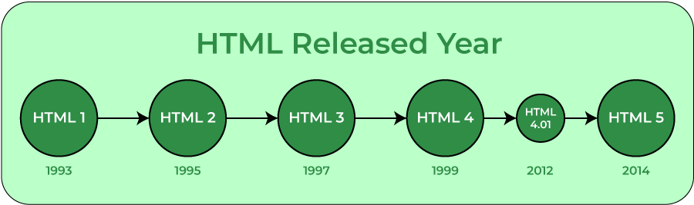
HTML (Hypertext Markup Language) is used to create document on the World Wide Web. It is simply a collection of certain key words called ‘Tags’ that are helpful in writing the document to be displayed using a browser on Internet.
It is a platform independent language that can be used on any platform such as Windows, Linux, Macintosh, and so on.

Slide 22
There are two types of tags :
• Container tags : The HTML tags which require a closing tag are called container tags. These tags are also called paired or wrapper tags. The <b> text </b> is one such pair. If you do not close such tags, all the following text would be treated as if they are part of this tag.
• Non-container tags : The HTML tags which do not require a closing tag are called non-container tags. These tags are also called stand alone or empty tags. A typical example is that of <br>. This tag inserts a line break.

Slide 23
HTML Tags or Elements
HTML tags are like keywords which defines that how web browser will format and display the content. With the help of tags, a web browser can distinguish between an HTML content and a simple content. HTML tags contain three main parts: opening tag, content and closing tag. But some HTML tags are unclosed tags.
HTML tags are used to mark-up HTML elements
HTML tags are surrounded by the two characters < and >
The surrounding characters are called angle brackets
HTML tags normally come in pairs like <b> and </b>
The first tag in a pair is the start tag, the second tag is the end tag
The text between the start and end tags is the element content
HTML tags are not case sensitive, <b> means the same as <B>

Slide 24
Tag Attributes
Tags can have attributes. Attributes can provide additional information about the HTML elements on your page.
Placed inside an opening tag, before the right-angle bracket.
Value is the value assigned to a given attribute. Values must be contained inside quotation marks
<body bgcolor="red">
This tag defines the body element with an added bgcolor attribute, which tells the browser that the background color of the page should be red.

Slide 25
Comments in HTML
Comments are some text or code written in your code to give an explanation about the code, and not visible to the user.
Comments which are used for HTML file are known as HTML comments. Anything written between these tags will be ignored by the browser, so comments will not be visible on the webpage.
You can add comments in your HTML file using <! -- ... --> tag.

Slide 26
Basic HTML Tags
<!DOCTYPE>
HTML <!DOCTYPE> tag is used to inform the browser about the version of HTML used in the document. It is called as the document type declaration (DTD).
Technically <!DOCTYPE > is not a tag/element, it just an instruction to the browser about the document type. It is a null element which does not contain the closing tag and must not include any content within it.
The doctype declaration differs between HTML versions. The HTML 5 doctype declaration is given below.
Syntax:
<!DOCTYPE html>

Slide 27
<html> … </html> — The root element. All web pages start with the html element. It’s also called the root element because it’s at the root of the tree of elements that make up a web page.
<head> … </head> — The document head. The head element contains information about the web page, as opposed to the web page content itself.
<title> … </title> — The page title. The title element contains the title of the page. The title is displayed in the browser’s title bar (the bar at the top of the browser window), as well as in bookmarks, search engine results, and many other places.
<body> … </body> — The page’s content. The body element appears after the head element in the page. It should contain all the content of your web page: text, images, and so on. All web pages have 1 single body element, with the exception of frameset pages, which contain frame elements instead.

Slide 28
<h1> … </h1> — A section heading. Headings let you break up your page content into readable chunks. They work much like headings and subheadings in a book or a report.
HTML headings are defined with the <h1> to <h6> tags.
<h1> defines the most important heading. <h6> defines the least important heading
<p> … </p> — A paragraph. The p element lets you create paragraphs of text. Most browsers display paragraphs with a vertical gap between each paragraph, nicely breaking up the text.
<img> — An image. The img element lets you insert images into your web pages. To insert an image, you first upload the image to your web server, then use an <img> tag to reference the uploaded image filename.

Slide 29
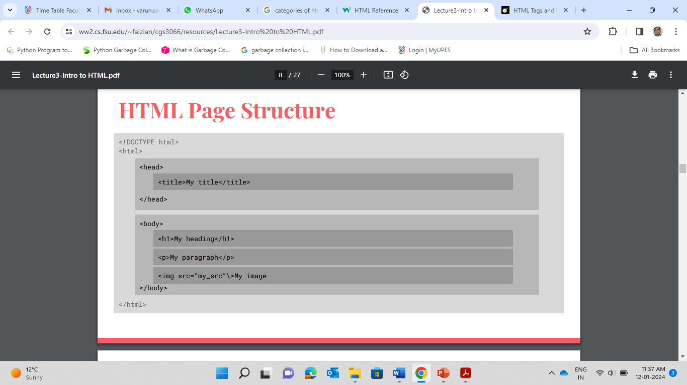
Structure of HTML Page

Slide 30
<html>
<head>
<title>
Title of the Page
</title>
</head>
<body>
<P> Enter Text </P>
</body>
</head>
</html>
Save the file with .html extension and open it in web browser.

Slide 31
Formatting Tags
Bold text
Bold text is used to highlight important text or headings. HTML5 provides two tags to make text bold:
1. <b> </b>
2. <strong> </strong>
Both tags have the same effect of making the enclosed text bold, but <strong> is preferred because it indicates that the text is important for semantic purposes, such as indicating a heading or key point.
<p> <strong> Enter Your Text </strong></p>

Slide 32
Italicized text
HTML5 provides two tags to make text italic:
1. <i>
2. <em>
Both tags have the same effect of making the enclosed text italic, but <em> is preferred because it indicates that the text has emphasis for semantic purposes.
<p><i> Text </i></p>
<p><em> Text </em></p>

Slide 33
Underline Text
It is used to underline a particular text. The content inside is typically displayed with an underline.
<u> Text </u>
Mark Text
The HTML <mark> element defines text that should be marked or highlighted:
<mark> Text </mark>
Please bring <mark> Notebooks</mark> tomorrow.
Small Text
<small> </small>
The HTML <small> element defines smaller text:
<small>This is some smaller text.</small>

Slide 34
<del> - </del>
The HTML <del> element defines text that has been deleted from a document. Browsers will usually strike a line through deleted text:
<p>My favorite color is <del>blue</del> red.</p>
<ins> </ins>
Defines a text that has been inserted into a document. Browsers will usually underline inserted text.
<p>My favorite color is <del>blue</del><ins> red.</ins></p>

Slide 35
<sub> - </sub>
The HTML <sub> element defines subscript text. Subscript text appears half a character below the normal line, and is sometimes rendered in a smaller font.
<sup> - </sup>
The HTML <sup> element defines superscript text. Superscript text appears half a character above the normal line, and is sometimes rendered in a smaller font.
<address> </address>
Defines contact information for the author/owner of a document/article. The text in the <address> element usually renders in italic, and browsers will always add a line break before and after the <address> element.

Slide 36
<progress> Tag
The <progress> tag represents the completion progress of a task.
Attributes Supported: max and Value.
<progress value="42" max="100"> </progress>

